Slide 1
Image Caption Generator - Project Outline

Slide 2

Presented By :
Team Perfect Squares:
Durgesh Mishra
Jai Saxena
Niranjan Solanki
Pankaj Balchandani

Slide 3
Problem Statement
Image Captioning is the process of generating a textual description for given images. A challenging problem in Deep learning is to auto-generate caption for an image.
To understand the context of an image and describe it in a human language like English, Image Caption Generator uses both Natural Language Processing (NLP) and Computer Vision to generate the captions.

Slide 4
Outline
Problem Statement
Problem Solution
Project workflow
Data
Models

Slide 5
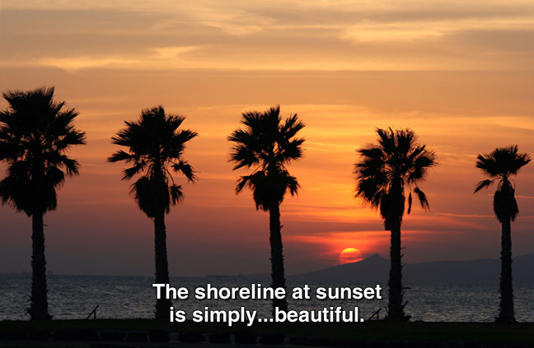
Problem Solution
We plan to build a user interface where given an image, we generate the relevant caption for that particular image using Computer vision & NLP-based models.

Slide 6
Project Scope
Proof Of Concept (POC)
Prototype
Minimum Viable Product (MVP)
Preprocess Image and Caption data
Experiment on some baseline models and approaches.
Visualize model activations to analyse whether the captions. generated are relevant or not.
Check for pixels in a given image that contributes to the captions & segment the given pixels.
Create a mockup of screens to see how the app could look like
Deploy one model to Fast API to service model predictions as an API
Create App to generate caption for an uploaded image
API Server for uploading images and predicting using best model

Slide 7
Project Workflow
POC
Prototype
MVP
Data Collection
Setup Experiment Tracking
Build Baseline Models
Build better Models
Project, Containers, Deployment Setup
Build Caption generating App

Slide 8
Dataset & Models
We will be experimenting with 2 datasets, whichever gives better result:
Flikr8K (32k Images) (https://www.kaggle.com/code/hsankesara/image-captioning/data
Coco Caption(328k images) https://paperswithcode.com/dataset/coco
Model:
Convolutional Neural Network (CNN) based models
Language based models

Slide 9
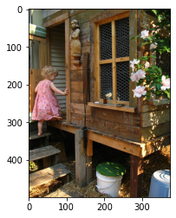
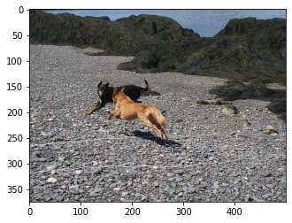
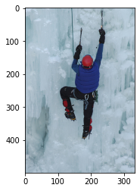
Data Details
Total number of images: 8000
Captions for each Image: 5
Size of the images vary from - >
x = 148, y = 164
x= 500 , y = 500
child in pink dress is climbing up set of stairs in an entry way
brown dog is running after the black dog
climber climbing ice wall

Slide 10
Preprocessing ..
Preprocessing of Images:
Augmentation was applied
Initial Implementation:
Every Image was compressed to (60,60,3)
After Understanding of RAM consumption:
Every Image was compressed to (120,120,3)
Preprocessing of Text:
Initial Implementation:
Text was preprocessed to remove unwanted characters.
After Understanding the varying text length of captions:
Text >15 length and text <5 length were removed for less sparsity.

Slide 11
Models
Computer Vision Task:
Small, Medium, Large CNN model
Transfer learning, Resnet50 model

Slide 12
Models - Training Results
S.no | Model | Epochs | Data subset size | Learning rate | Optimizer | Batch_size | Accuracy | Loss
1 | CNN2D 4Layer + LSTM 1Layer | 10 | 10000 Images | 0.001 | Adam | 32 | 27% | 2.93
2 | CNN2D 6Layer + LSTM 1Layer | 10 | 10000 Images | 0.001 | Adam | 64 | 28% | 2.84
3 | CNN2D 8Layer + LSTM 1Layer | 10 | 20000 Images | 0.001 | Adam | 64 | 29% | 2.85
4 | Resnet50 + LSTM 1Layer (preserving all weights of conv layers ) | 10 | 20000 Images | 0.001 | Adam | 128 | 28% | 2.83
5 | Resnet50 + LSTM 1Layer (training last convolution layer) | 10 | 20000 Images | 0.001 | Adam | 128 | 32% | 2.724
Above Accuracy measure is the measure of how good the model is predicting new word but since each image has 5 different captions accuracy could go down.
Will come with more reliable accuracy measure.

Slide 13
Thank you!!

